Slide 1

Classifying Distracted Driving
Dylan C Neal

Slide 2
Background

Slide 3

Background
~8 people killed each day in USA due to distracted driving¹
3 categories of distraction:
Visual (eyes off road)
Manual (hands off wheel)
Cognitive (mind off task)
Can we better identify these driving behaviors with machine learning?
1 Centers for Disease Control and Prevention. 2020. “Distracted Driving.” Motor Vehicle Safety.
https://www.cdc.gov/motorvehiclesafety/distracted_driving/.

Slide 4
Data

Slide 5
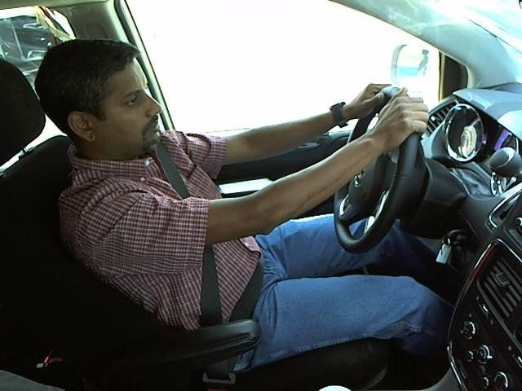
Data
State Farm Kaggle Competition
10 classes:
c0 = safe driving

Slide 6
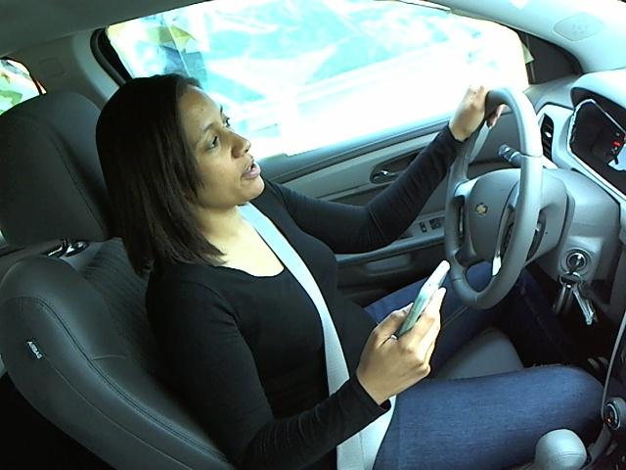
Data
State Farm Kaggle Competition
10 classes:
c1 = texting – right hand

Slide 7
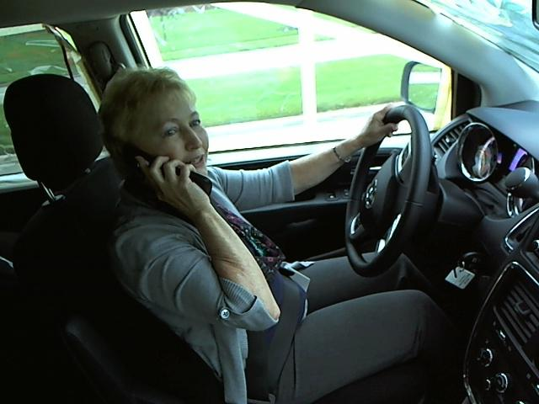
Data
State Farm Kaggle Competition
10 classes:
c2 = talking on phone – right hand

Slide 8
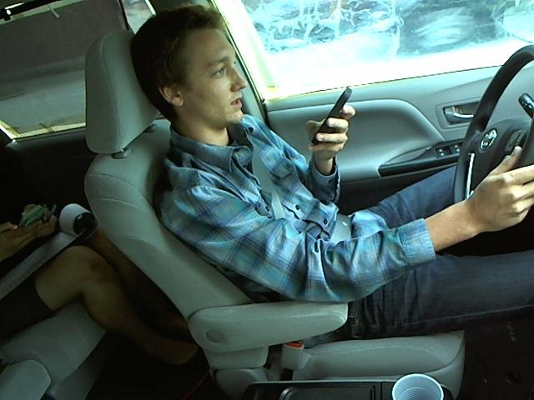
Data
State Farm Kaggle Competition
10 classes:
c3 = texting – left hand

Slide 9
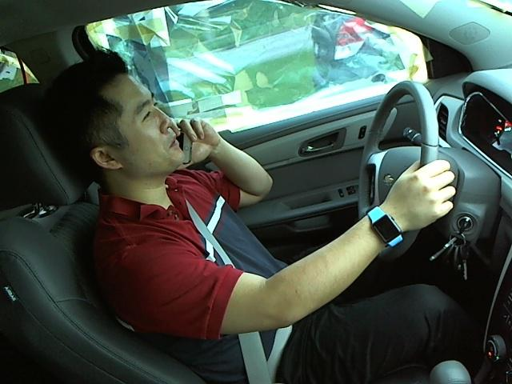
Data
State Farm Kaggle Competition
10 classes:
c4 = talking on phone – left hand

Slide 10
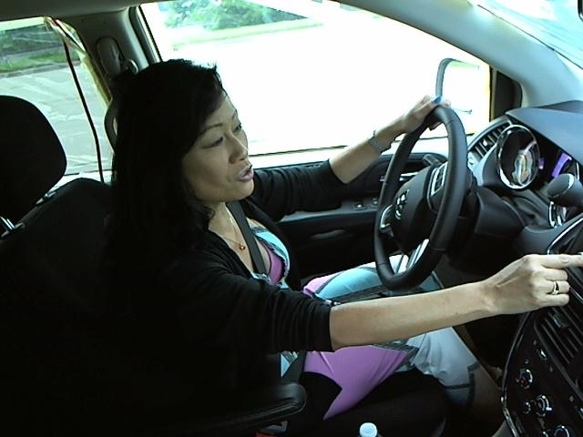
Data
State Farm Kaggle Competition
10 classes:
c5 = operating radio

Slide 11
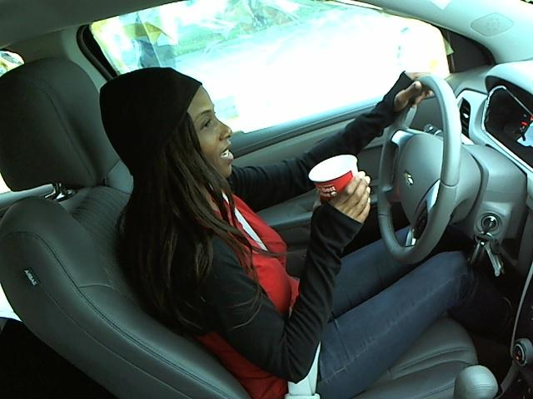
Data
State Farm Kaggle Competition
10 classes:
c6 = drinking

Slide 12
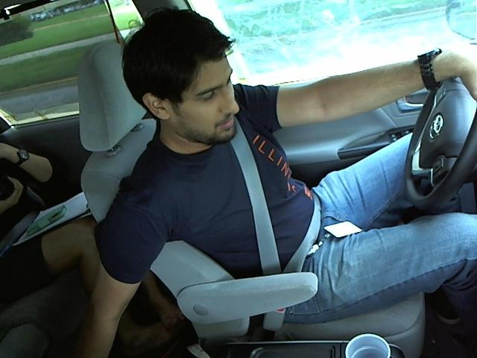
Data
State Farm Kaggle Competition
10 classes:
c7 = reaching behind

Slide 13
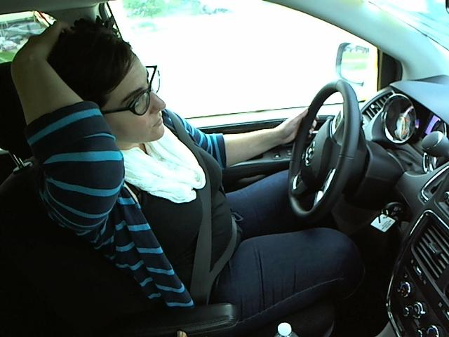
Data
State Farm Kaggle Competition
10 classes:
c8 = hair and makeup

Slide 14
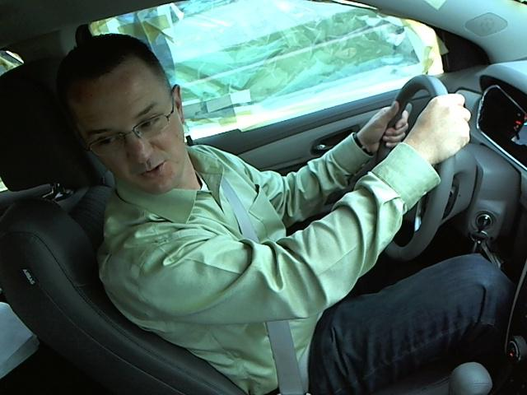
Data
State Farm Kaggle Competition
10 classes:
c9 = talking to passenger

Slide 15

Challenges
Subjects in test data are not present in training data
Training data are class imbalanced
Training data are subject imbalanced

Slide 16
Data prep

Slide 17
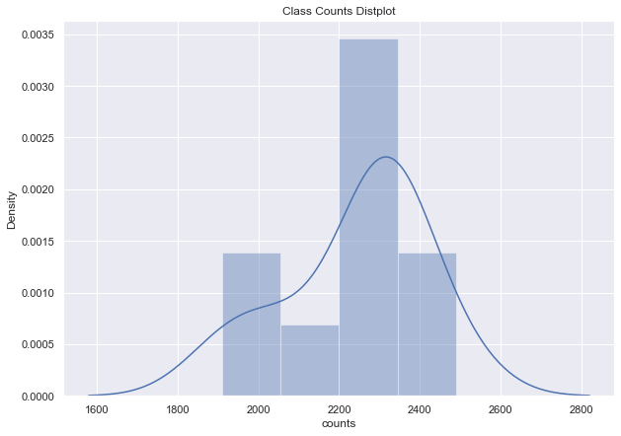
EDA
Class Imbalance

Slide 18
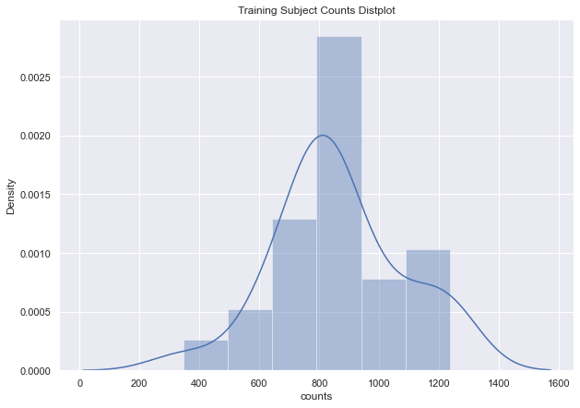
EDA
Subject Imbalance

Slide 19

Solution
Under/oversample to standardize training data
Make each subject appear equal times in each class in training data
Random seed sampling function to allow option for repeated bootstrapping

Slide 20
Modeling
Convolutional Neural Networks with Keras

Slide 21
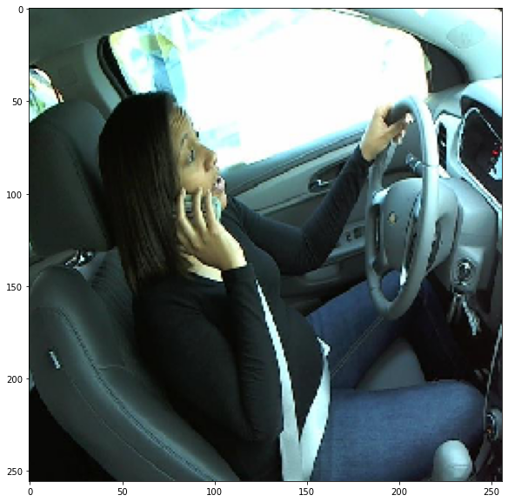
Loading/Pre-Processing Data
Keras ImageDataGenerator class
Pre-process images as they load in batches

Slide 22
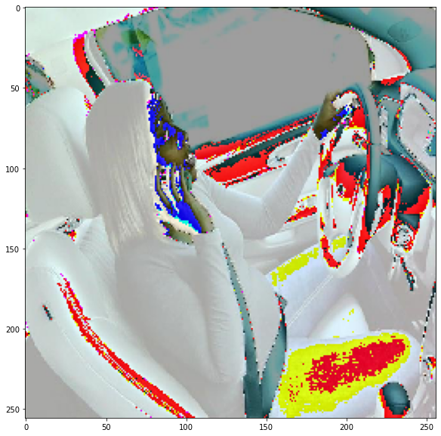
Loading/Pre-Processing Data
Keras ImageDataGenerator class
Pre-process images as they load in batches
Example: samplewise_center = True
Randomized training image processing improves training data utility

Slide 23
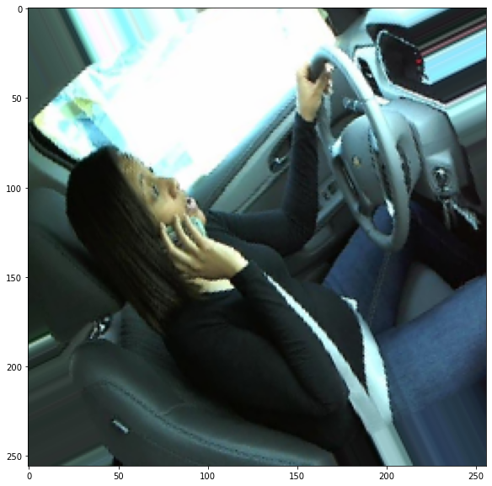
Loading/Pre-Processing Data
Keras ImageDataGenerator class
Pre-process images as they load in batches
Example: samplewise_center = True
Randomizing training image processing improves training data utility
Example: rotation_range = 40

Slide 24
Loading/Pre-Processing Data
Training Data
Samplewise center
Rescale pixel intensity between 0-1
Randomize several parameters:
Rotation
Width shift
Height shift
Channel shift
Shear
Zoom
Brightness
Validation and Test Data
Samplewise center
Rescale pixel intensity between 0-1

Slide 25

Validation Split and Training
4 out of 26 training subjects isolated as validation data
During training, validation data frequently evaluated by neural network to prevent overfitting
Weights tied to best validation score saved to model

Slide 26
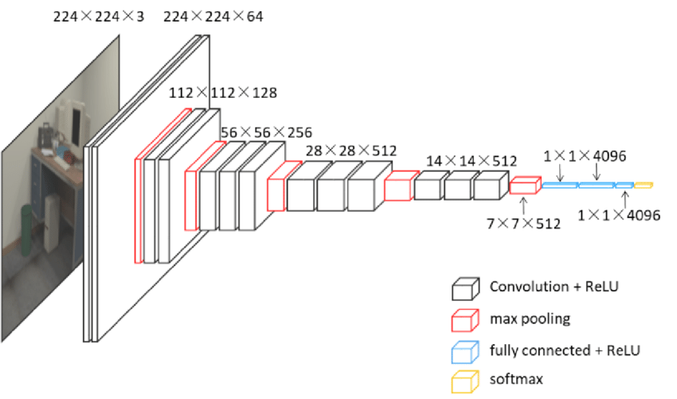
Model Architecture – VGG16

Slide 27

Transfer Learning
Pre-trained VGG16 on ImageNet data
Load model without final layer
Add last fully-connected layer with desired output (i.e. 10 classes with softmax activation function)
Train only the parameters for the final fully connected layer and output layer
Loss function: categorical cross entropy

Slide 28
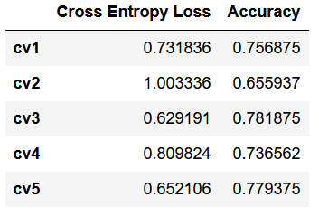
Cross-Validation Ensembling
The model was trained from scratch 5 separate times
Each fold had a different 4 subjects isolated as validation data
Predictions from trained CV folds are averaged to generate ensembled model

Slide 29
Final Metrics

Slide 30
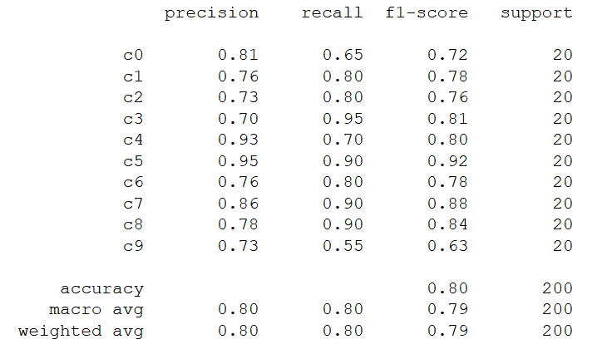
Test Data – Labeled Subset
Test data > 700,000 images not labeled (Kaggle competition)
Subset of 200 test images hand labeled for additional performance metrics
Cross Entropy Loss = 0.5768
Struggled the most to classify c9 (talking to passenger) and c0 (safe driving).

Slide 31
Test Data – Full Set
Upon submitting the ensembled predictions to Kaggle the cross-entropy loss scores were as follows:
Private Score = 0.74193 - Scoreboard position of 425 out of 1,439 (70th percentile)
Public Score = 0.76031 - Scoreboard position of 437 out of 1,439 (69th percentile)

